Slide 1



Real Time Face Attendance
System
Presented by:
Parth Sharma AF04977352

Slide 2
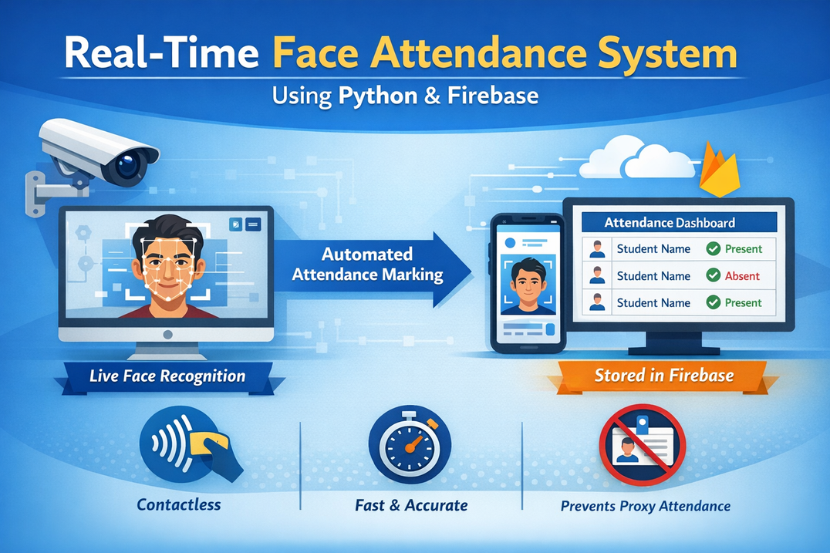
Abstract
This project presents a Real-Time Face Attendance System using Python and Firebase.
The system captures live video, recognizes faces using computer vision techniques, and automatically marks attendance.
Attendance records are stored in Firebase and updated in real time.
The solution is contactless, fast, and reduces proxy attendance, making it suitable for educational institutions and organizations.

Slide 3
Project Objective and Tools used
Objective:
To design and develop a real-time face recognition–based attendance system.
To automate attendance marking and eliminate proxy attendance.
To provide a contactless, fast, and accurate attendance solution.
To store and update attendance data in real time using Firebase.
To create a scalable system suitable for classrooms, offices, and institutions.
Tools and Libraries Used:
Python
face_recognition
numpy
firebase_admin
cv2
cvzone
os
pickle
date-time

Slide 4
Modules Overview
1. firebase_admin 🔐
Used to connect the Python backend securely with Firebase.
Enables real-time read/write operations for attendance data.
Ensures authenticated and authorized access to Firebase services.
2. pickle 📂
Used to store and load face encodings (embeddings) efficiently.
Helps in fast retrieval of trained face data during recognition.
Reduces processing time by avoiding repeated training.
3. face_recognition 🧠
Core library for face detection and face recognition.
Converts facial features into numerical embeddings.
Compares live faces with stored data to identify individuals.

Slide 5
Modules Overview
4. cv2 📷
Used to capture live video from the camera.
Handles image preprocessing like resizing and frame conversion.
Plays a key role in real-time image processing.
5. os 🗂️
Used for file and directory handling operations.
Manages image paths, dataset folders, and local files.
Helps in system-level operations like file access.
6. storage ☁️
Used to upload and retrieve face images from Firebase Cloud Storage.
Ensures secure and scalable storage of image data.
Stores image URLs instead of raw image data in the database.
7.credentials 🔑
Used to authenticate the application with Firebase.
Ensures only authorized backend access to Firebase services.
Prevents unauthorized data manipulation.
8.datetime ⏰
Used to record date and time of attendance.
Helps in maintaining daily attendance logs.
Prevents multiple attendance entries for the same day.

Slide 6
Modules Overview
7. credentials 🔑
Used to authenticate the application with Firebase.
Ensures only authorized backend access to Firebase services.
Prevents unauthorized data manipulation.
8. datetime ⏰
Used to record date and time of attendance.
Helps in maintaining daily attendance logs.
Prevents multiple attendance entries for the same day.

Slide 7
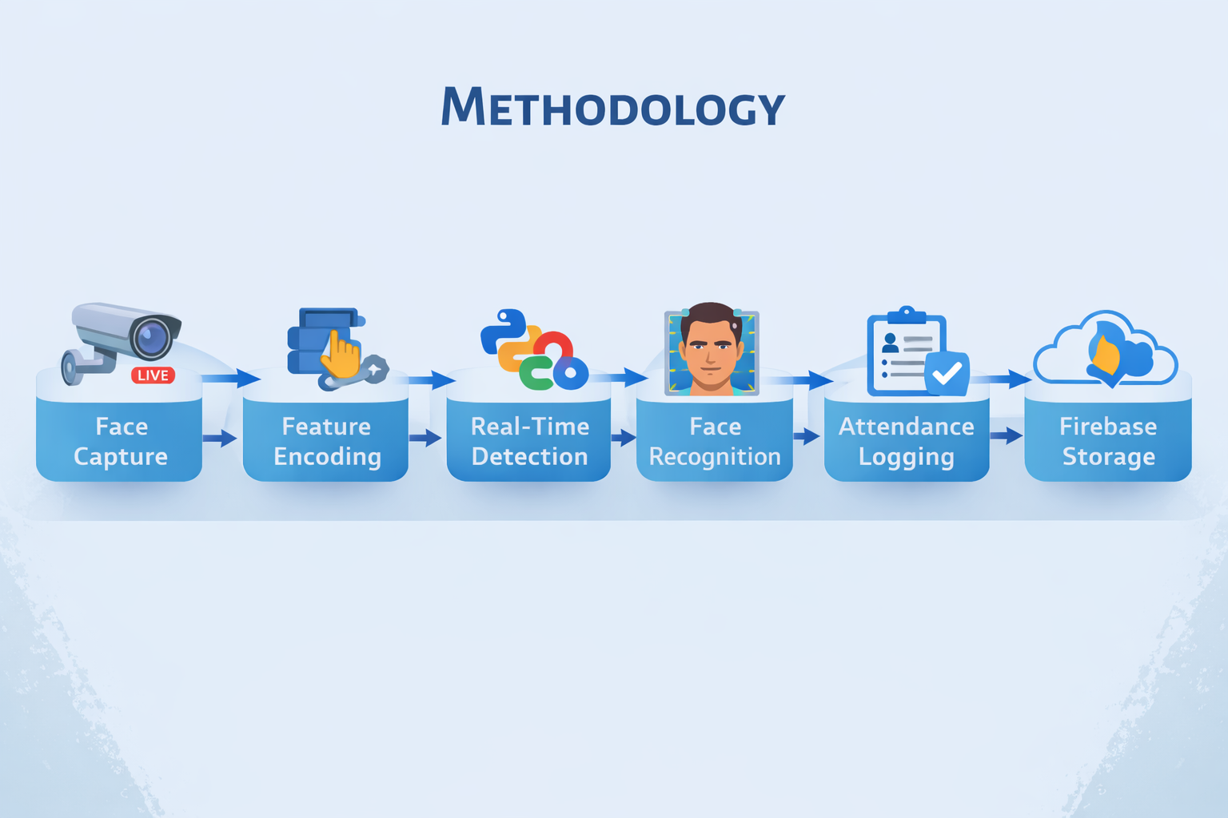
Methodology

Slide 8
Conclusions
The Real-Time Face Attendance System provides an accurate and automated solution for attendance management.
It reduces manual effort, prevents proxy attendance, and improves efficiency.
The integration of Python-based face recognition with Firebase enables real-time and secure data storage.
The system is scalable and can be extended for institutions, offices, and smart environments.

Slide 9
Thank You

